Slide 1
The Data Link Layer
Chapter 3

Slide 2
Data Link Layer Design Issues
Services Provided to the Network Layer
Framing
Error Control
Flow Control

Slide 3
Functions of the Data Link Layer
Provide service interface to the network layer
Dealing with transmission errors
Regulating data flow
Slow receivers not swamped by fast senders

Slide 4
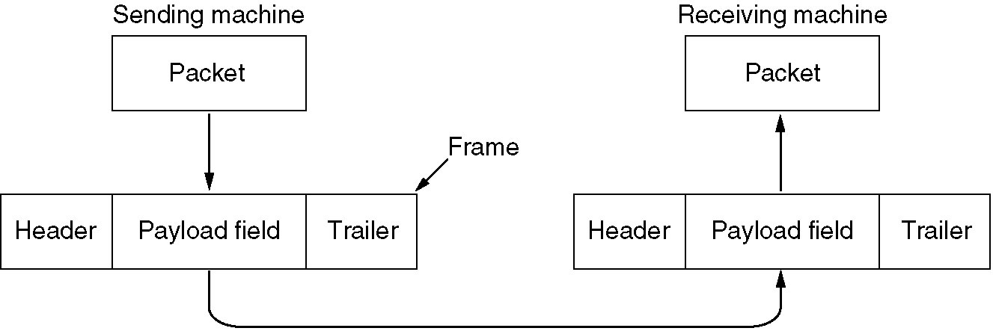
Functions of the Data Link Layer (2)
Relationship between packets and frames.

Slide 5
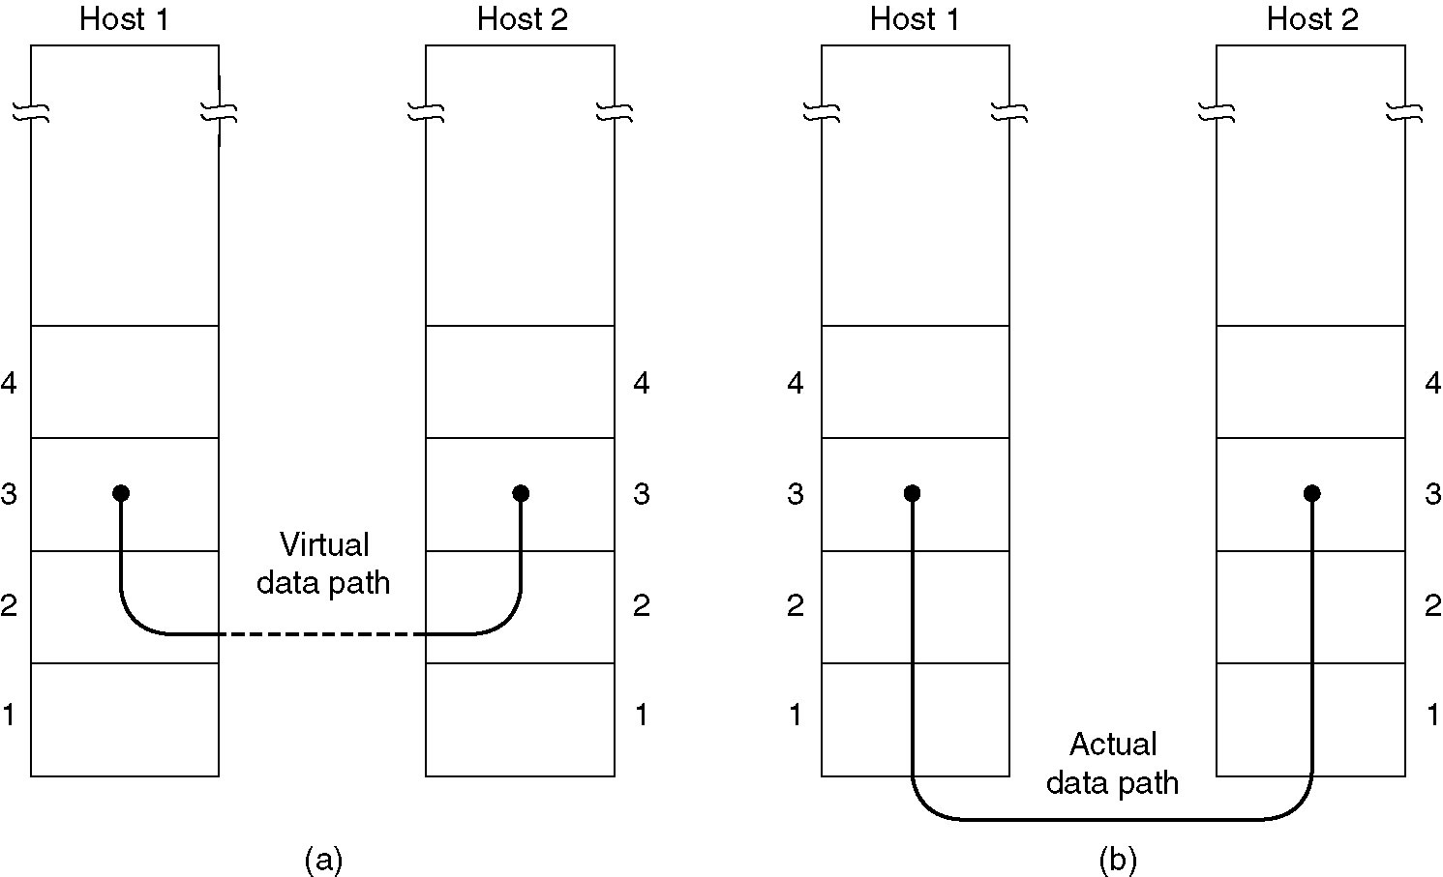
Services Provided to Network Layer
(a) Virtual communication.
(b) Actual communication.

Slide 6
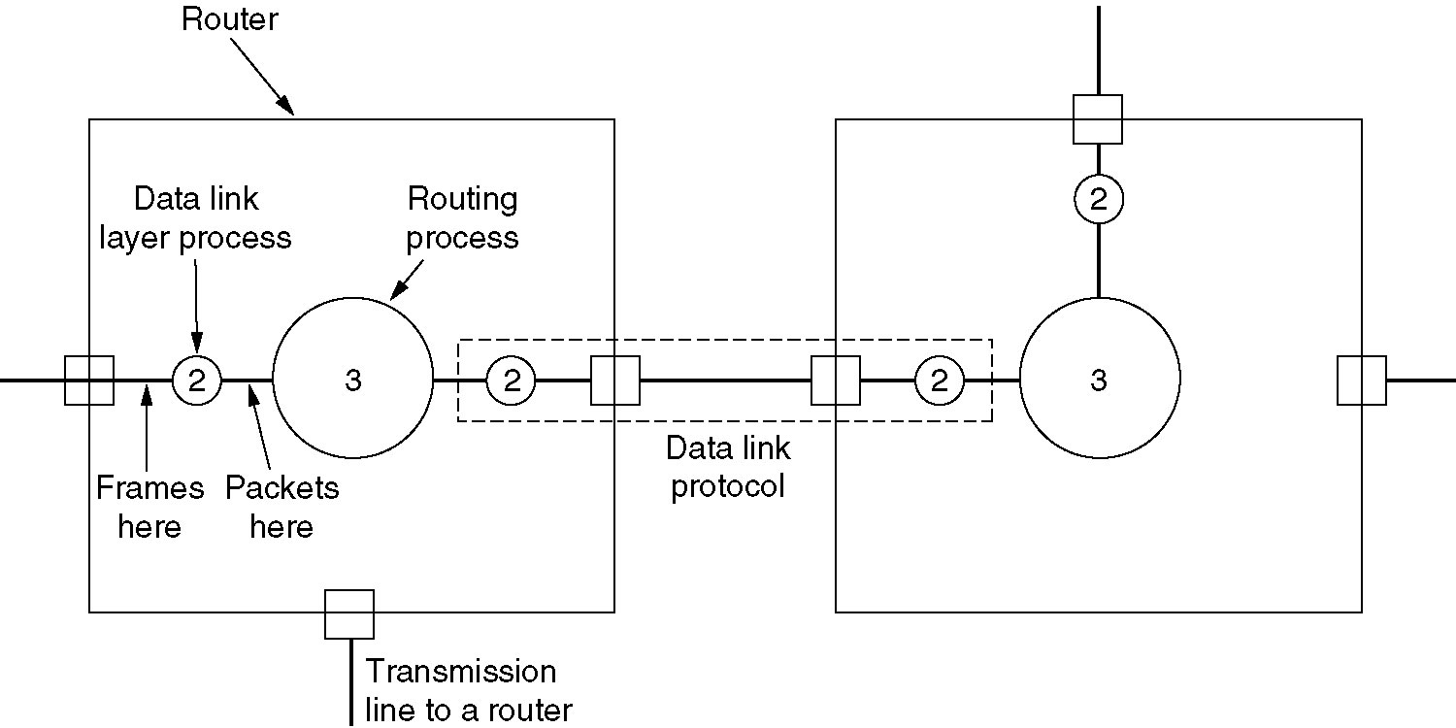
Services Provided to Network Layer (2)
Placement of the data link protocol.

Slide 7
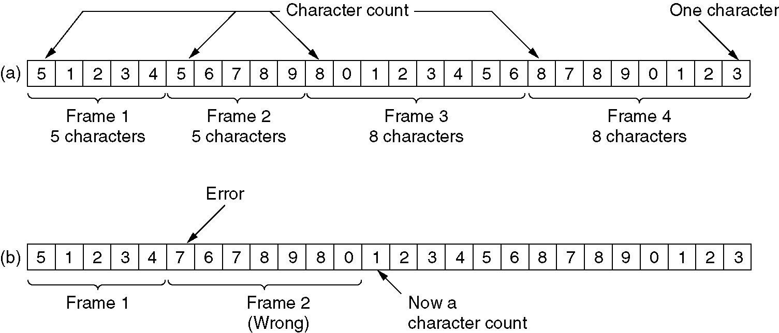
Framing
A character stream. (a) Without errors. (b) With one error.

Slide 8
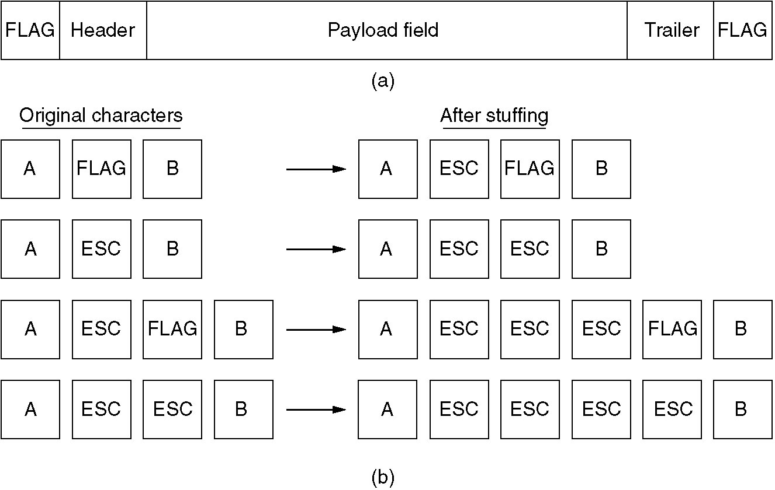
Framing (2)
(a) A frame delimited by flag bytes.
(b) Four examples of byte sequences before and after stuffing.

Slide 9
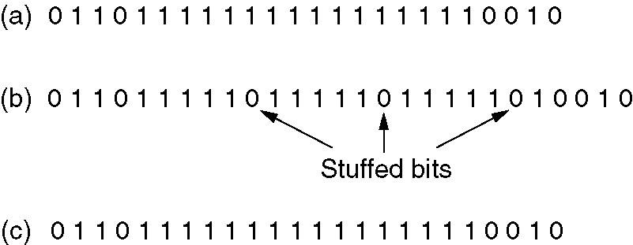
Framing (3)
Bit stuffing
(a) The original data.
(b) The data as they appear on the line.
(c) The data as they are stored in receiver’s memory after destuffing.

Slide 10
Error Detection and Correction
Error-Correcting Codes
Error-Detecting Codes

Slide 11
Error-Correcting Codes
Only a subset of all possible combinations will be used
There should be enough “gap” between two valid codewords so that when an error occurs, we can correct it back to nearest valid codeword
This gap is commonly known is hamming distance
1. Hamming codes.
2. Binary convolutional codes.
3. Reed-Solomon codes.
4. Low-Density Parity Check codes.

Slide 12
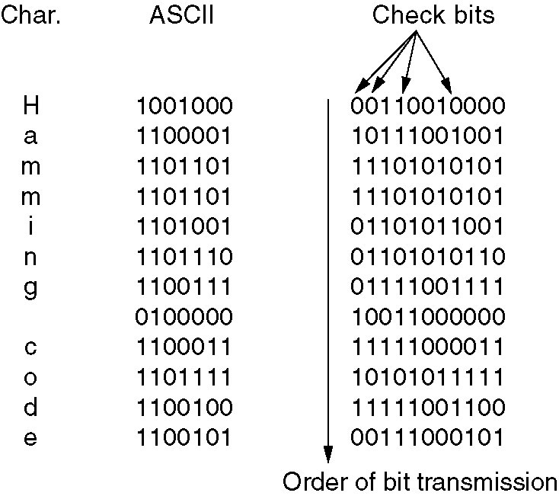
Error-Correcting Codes
Use of a Hamming code to correct burst errors.

Slide 13
Error-Detecting Codes
1. Parity.
2. Checksums.
3. Cyclic Redundancy Checks (CRCs).

Slide 14
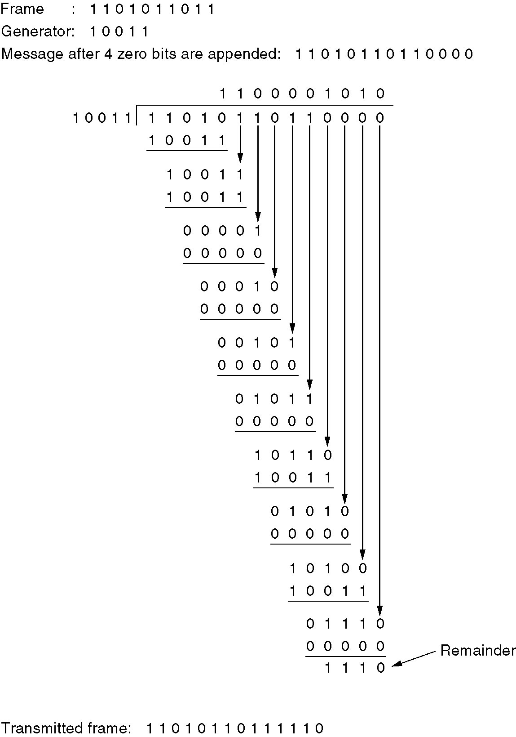
Error-Detecting Codes
Calculation of the polynomial code checksum.

Slide 15
Elementary Data Link Protocols
An Unrestricted/Utopian Simplex Protocol
A Simplex Stop-and-Wait Protocol
A Simplex Protocol for a Noisy Channel

Slide 16
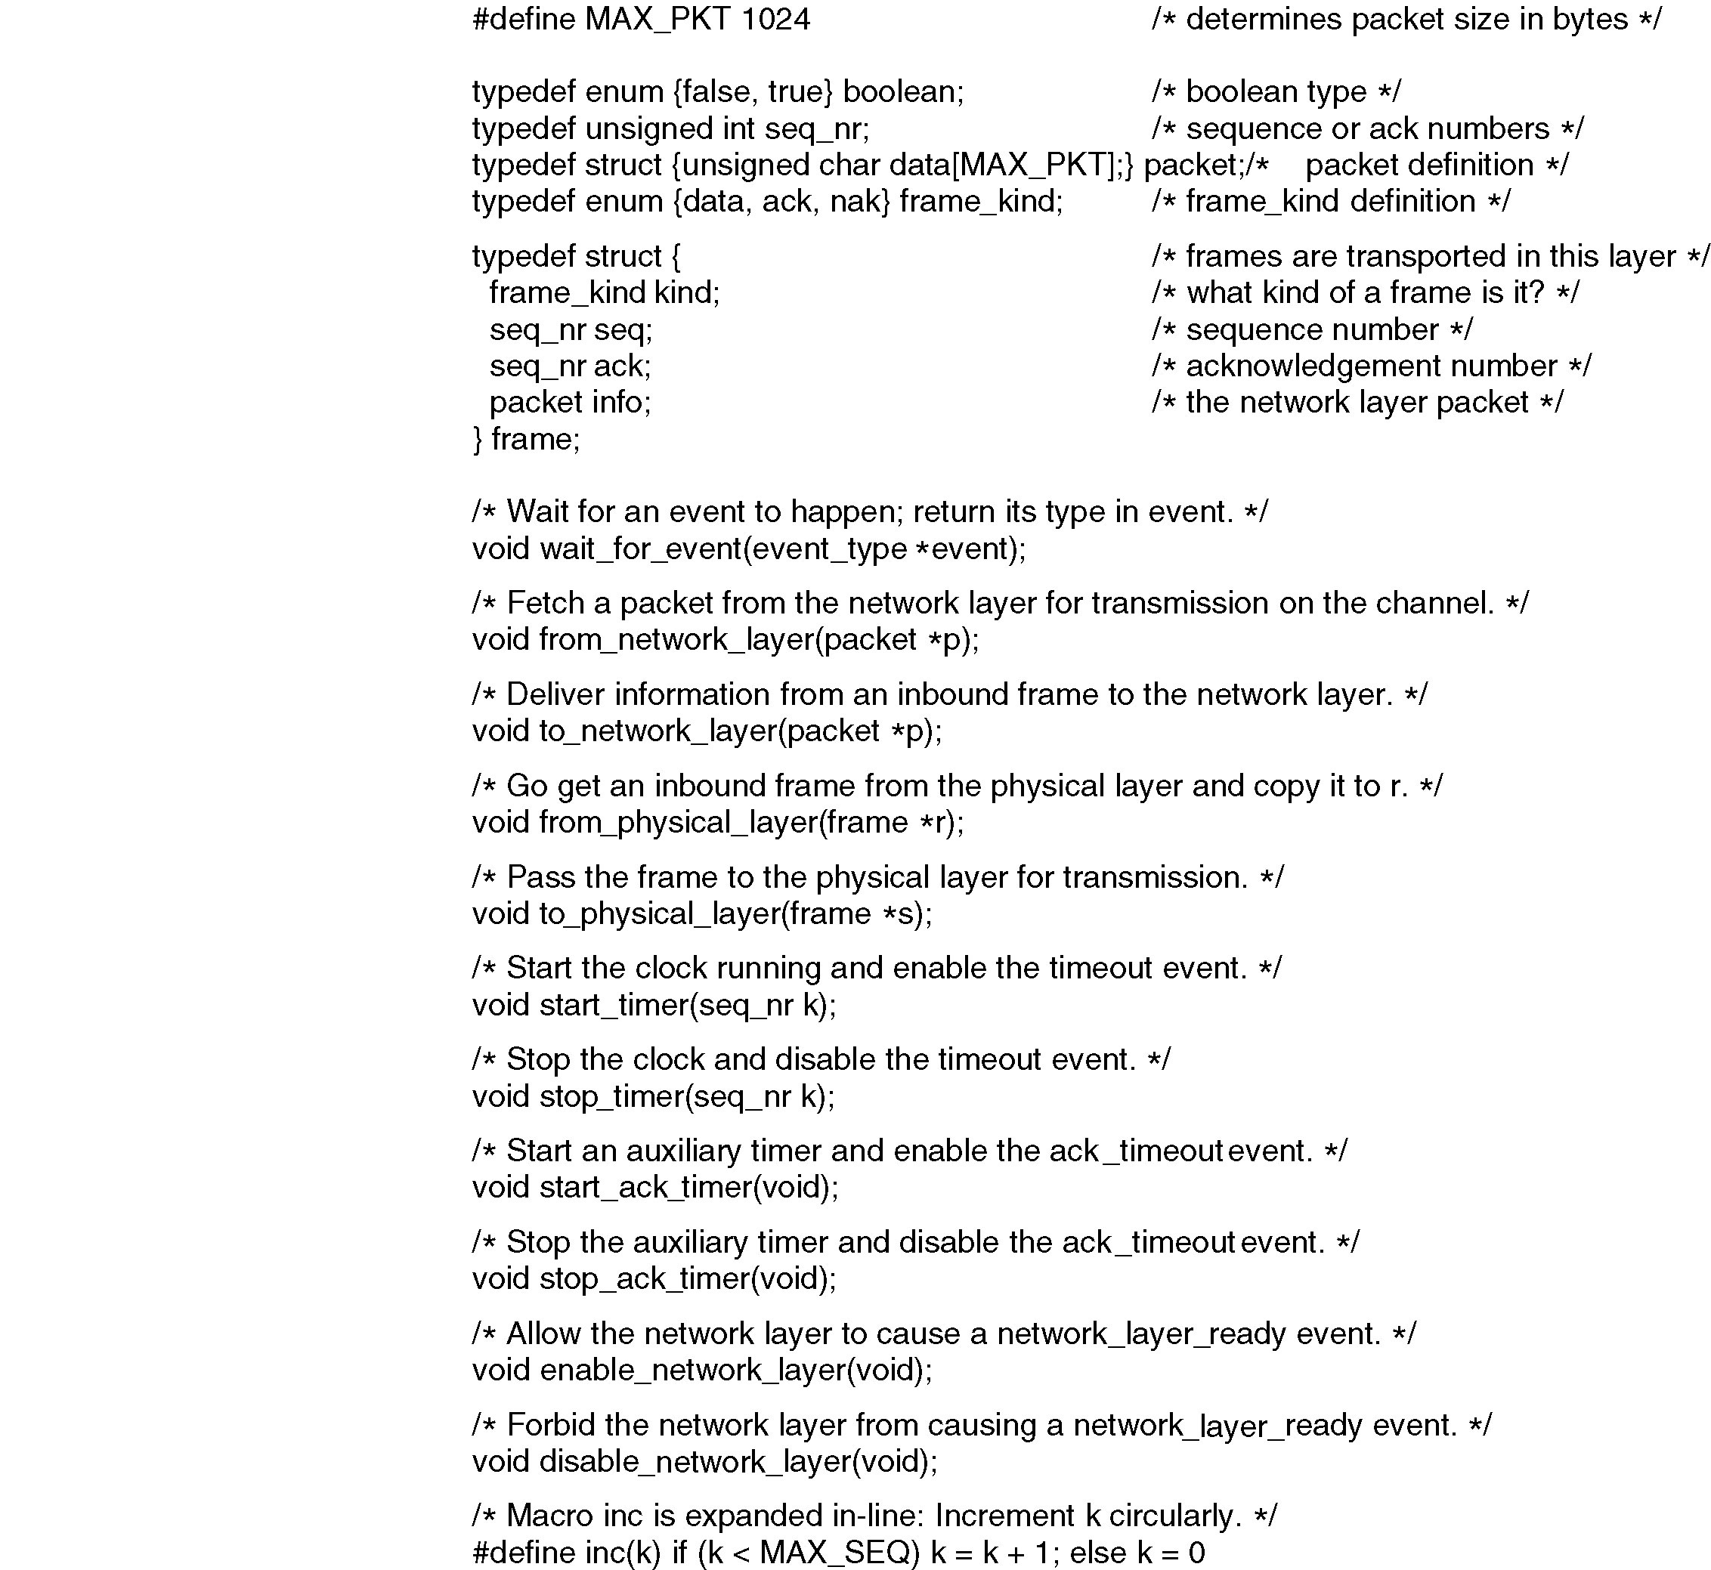
Protocol Definitions
Continued 🡪
Some definitions needed in the protocols to follow. These are located in the file protocol.h.

Slide 17
Protocol Definitions (ctd.)
Some definitions needed in the protocols to follow. These are located in the file protocol.h.

Slide 18
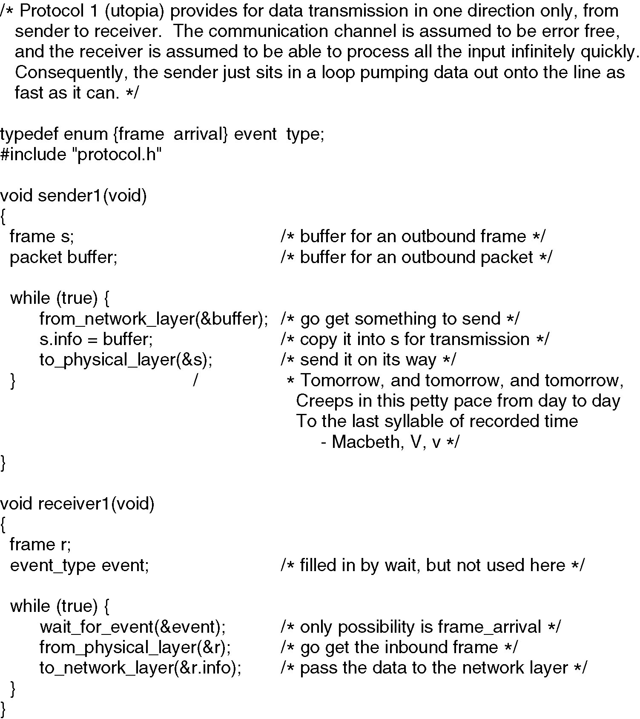
Unrestricted Simplex Protocol

Slide 19
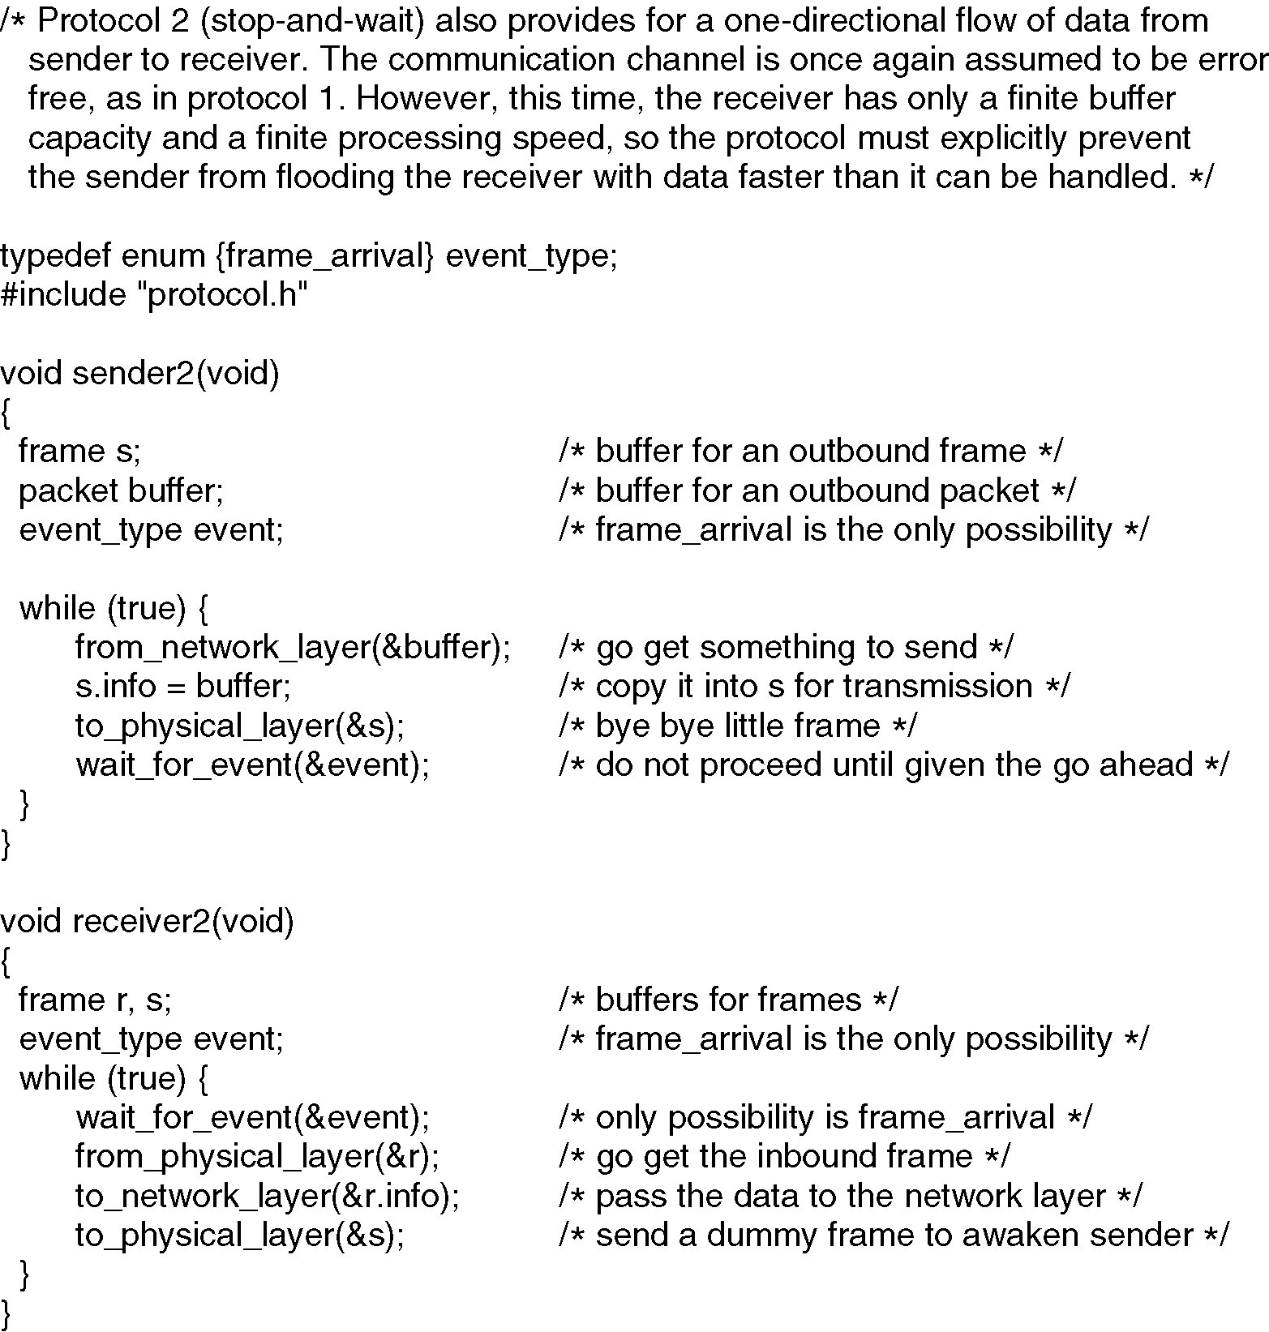
Simplex Stop-and-Wait Protocol

Slide 20
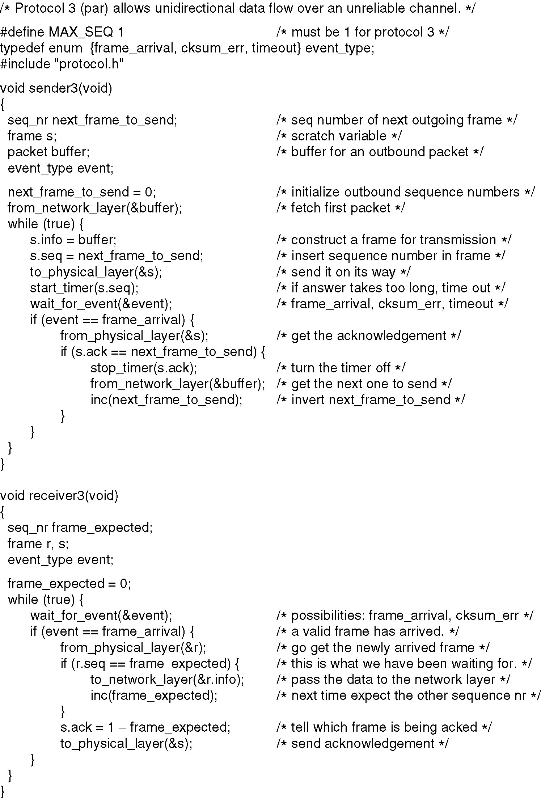
A Simplex Protocol for a Noisy Channel
A positive acknowledgement with retransmission protocol.
Continued 🡪

Slide 21
A Simplex Protocol for a Noisy Channel (ctd.)
A positive acknowledgement with retransmission protocol.

Slide 22
Sliding Window Protocols
A One-Bit Sliding Window Protocol
A Protocol Using Go Back N
A Protocol Using Selective Repeat

Slide 23
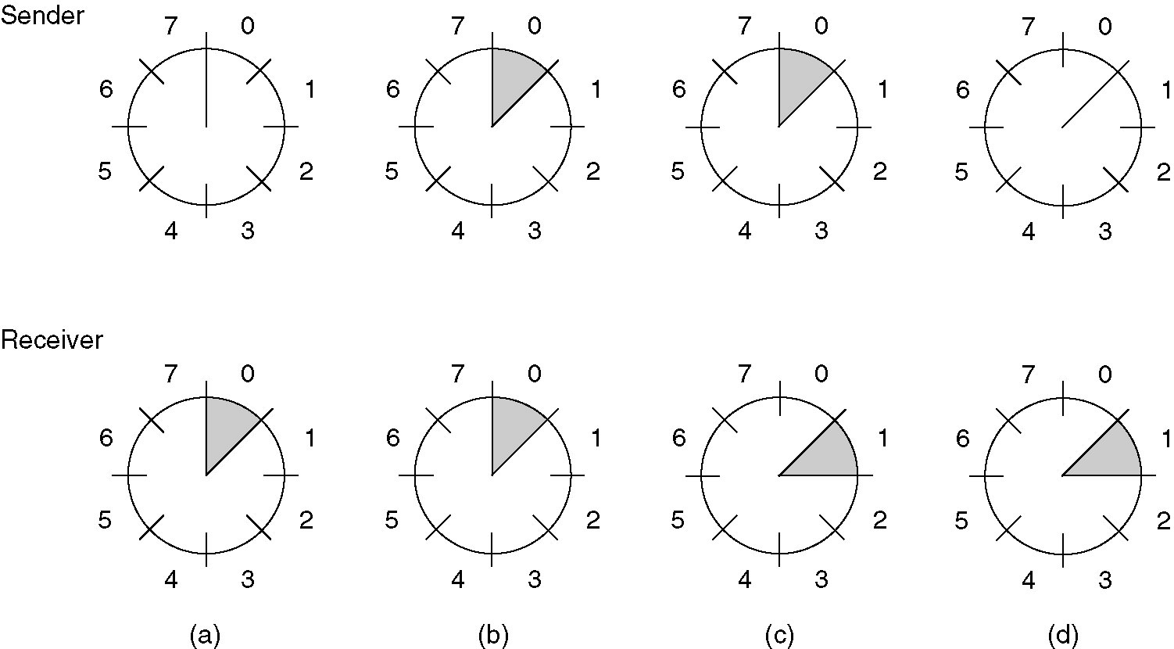
Sliding Window Protocols (2)
A sliding window of size 1, with a 3-bit sequence number.
(a) Initially.
(b) After the first frame has been sent.
(c) After the first frame has been received.
(d) After the first acknowledgement has been received.

Slide 24
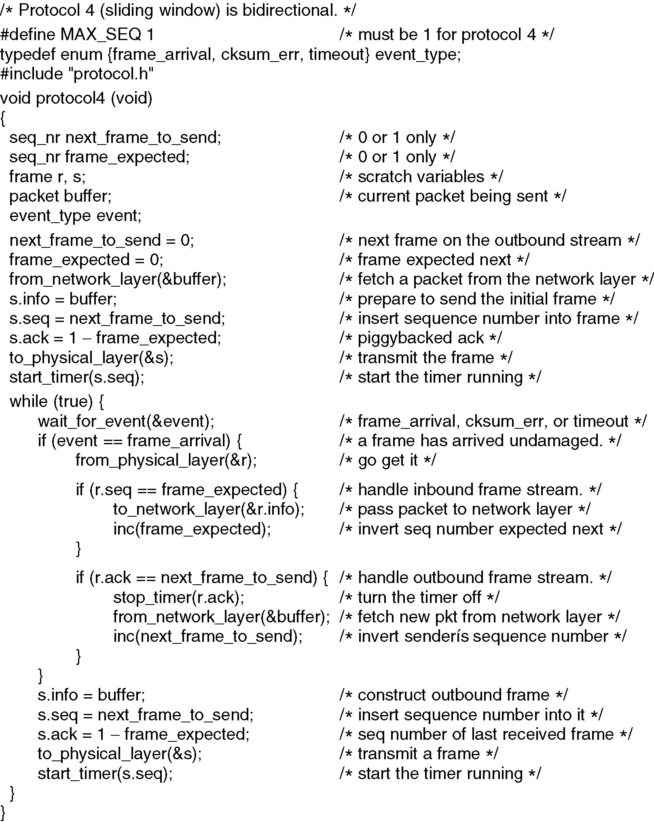
A One-Bit Sliding Window Protocol
Continued 🡪

Slide 25
A One-Bit Sliding Window Protocol (ctd.)

Slide 26
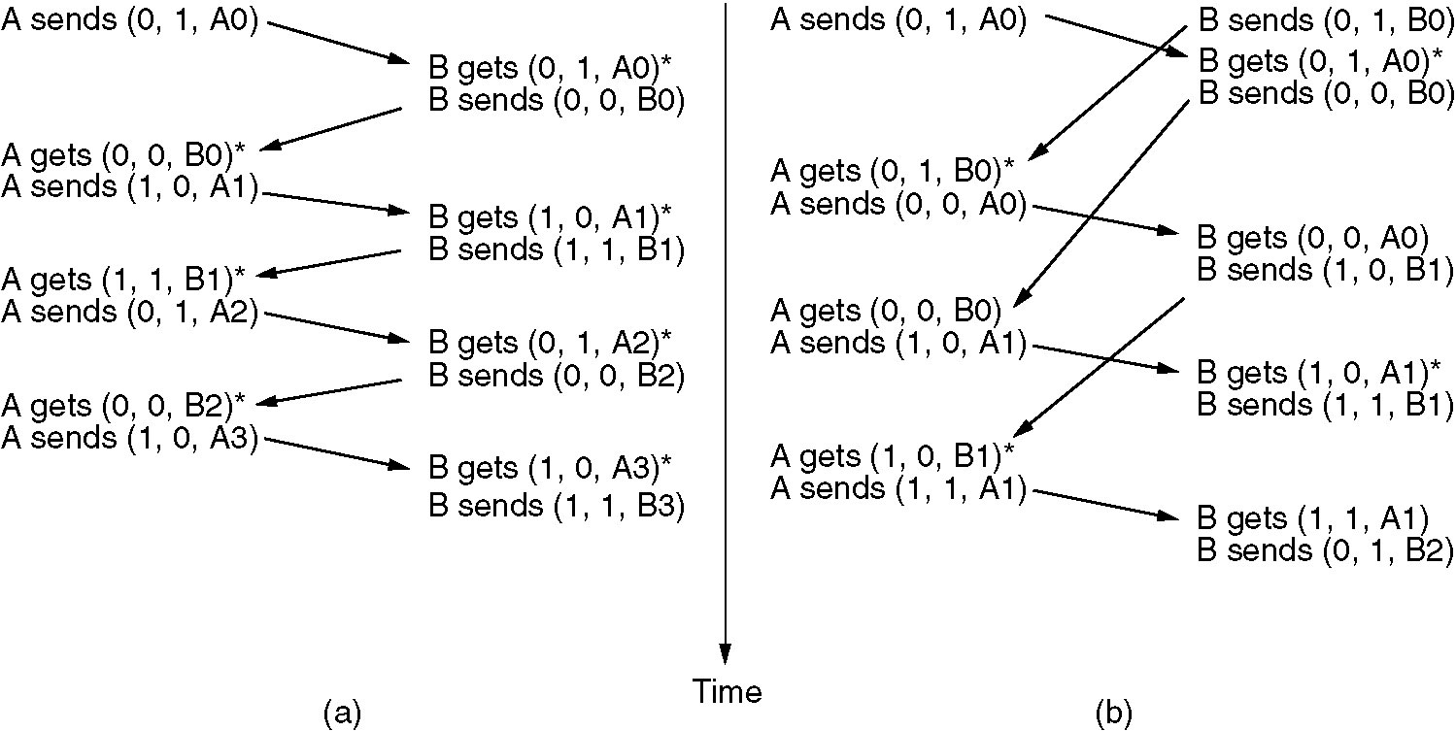
A One-Bit Sliding Window Protocol (2)
Two scenarios for protocol 4. (a) Normal case. (b) Abnormal case. The notation is (seq, ack, packet number). An asterisk indicates where a network layer accepts a packet.

Slide 27
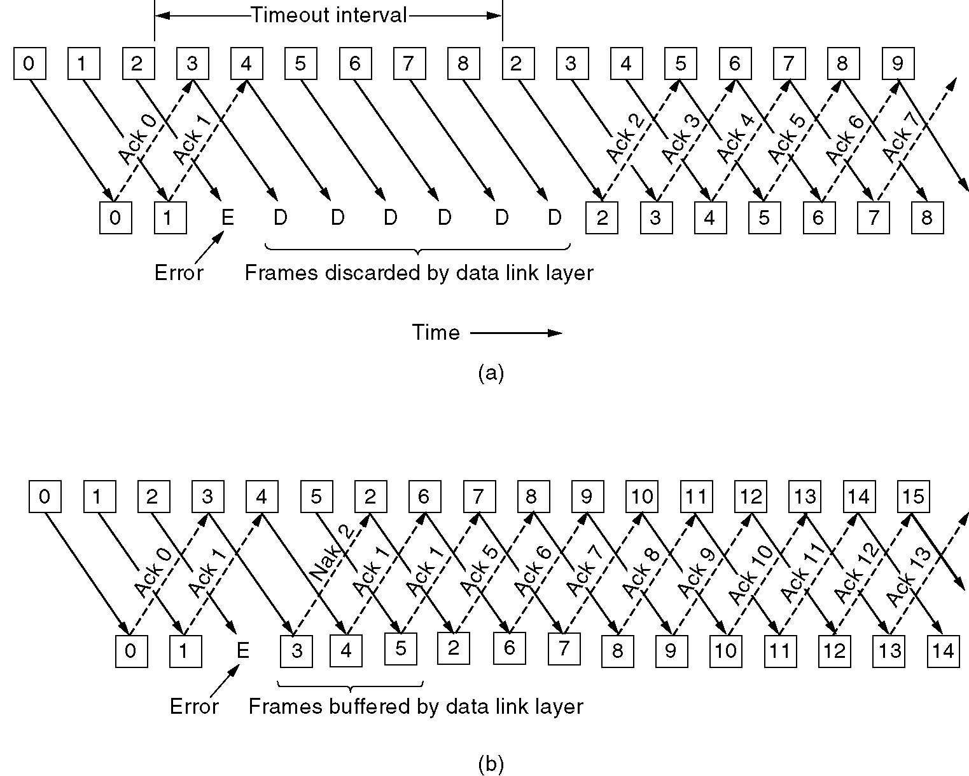
A Protocol Using Go Back N
Pipelining and error recovery. Effect on an error when
(a) Receiver’s window size is 1.
(b) Receiver’s window size is large.

Slide 28
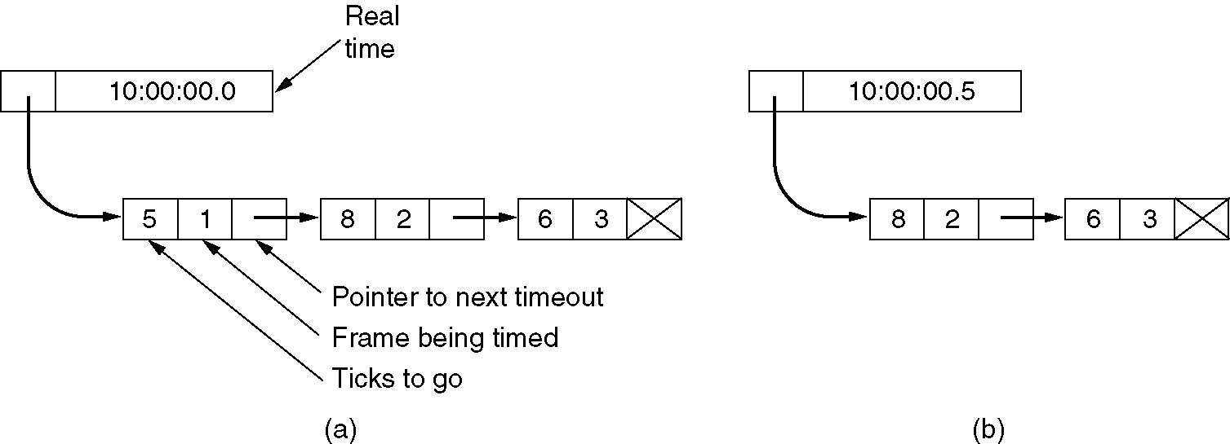
Sliding Window Protocol Using Go Back N (2)
Simulation of multiple timers in software.

Slide 29
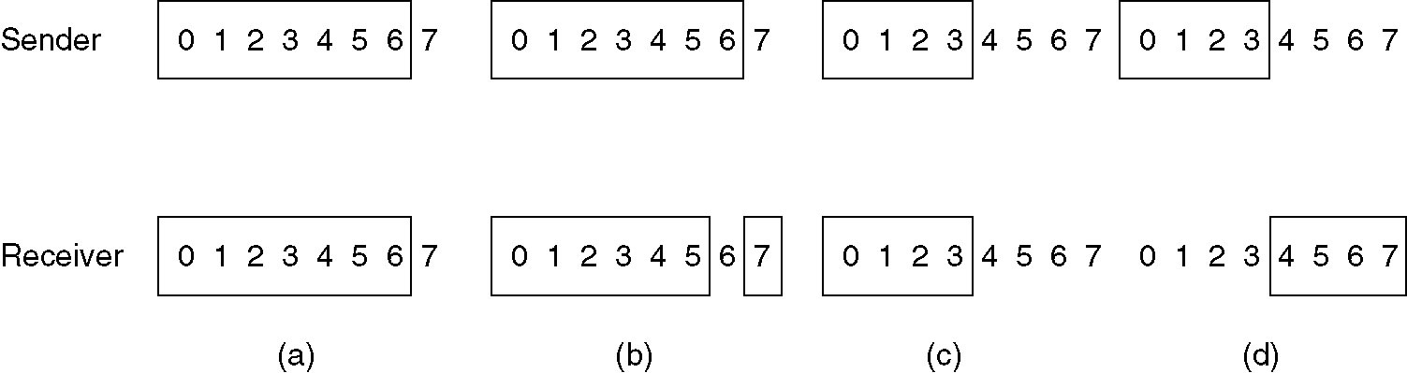
A Sliding Window Protocol Using Selective Repeat
(a) Initial situation with a window size seven.
(b) After seven frames sent and received, but not acknowledged.
(c) Initial situation with a window size of four.
(d) After four frames sent and received, but not acknowledged.

